Slide 1
Pre-Algebra Extras [hot mess of everything that isnt covered by the other slides – still extremely useful; can be updated randomly and irregularly]
By Hurles

Slide 2
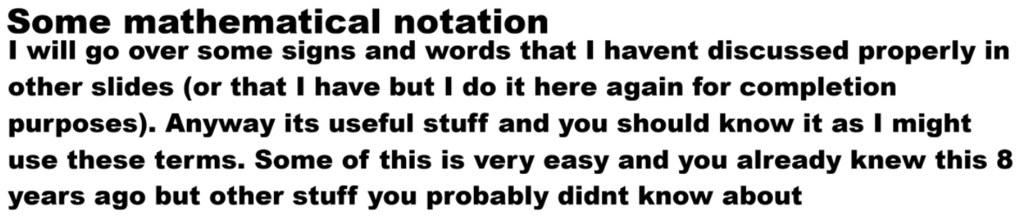

Slide 3
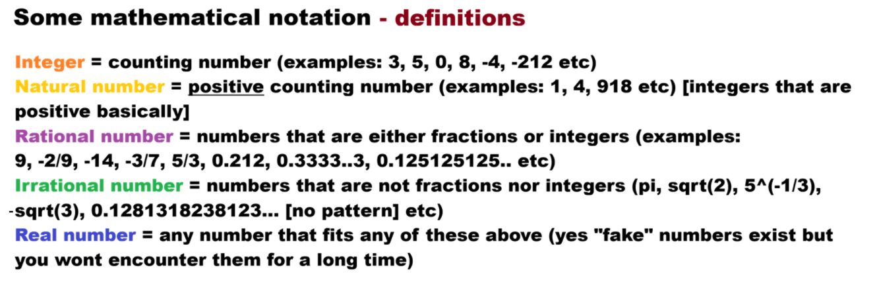
Even number = integers divisible by 2 (so 0, 2, 4 etc but also -2, -4, -6 etc) Odd number = integers that are not divisible by 2 (so 1, 3, 5, 7 etc and -1, -3, -5 etc)

Slide 4
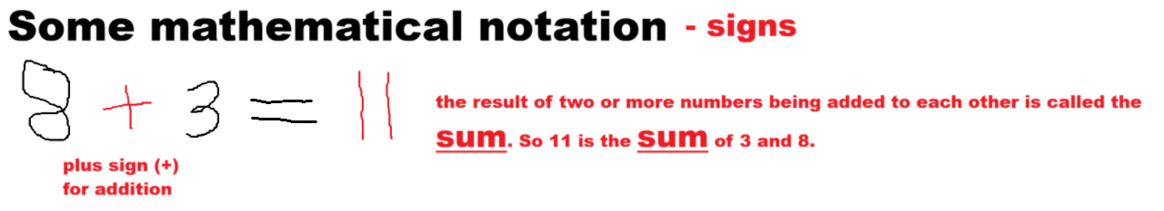

Slide 5
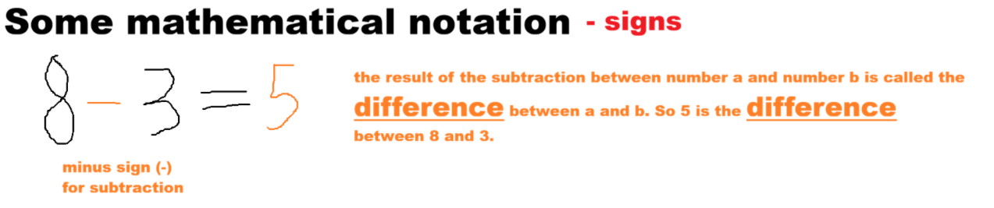

Slide 6
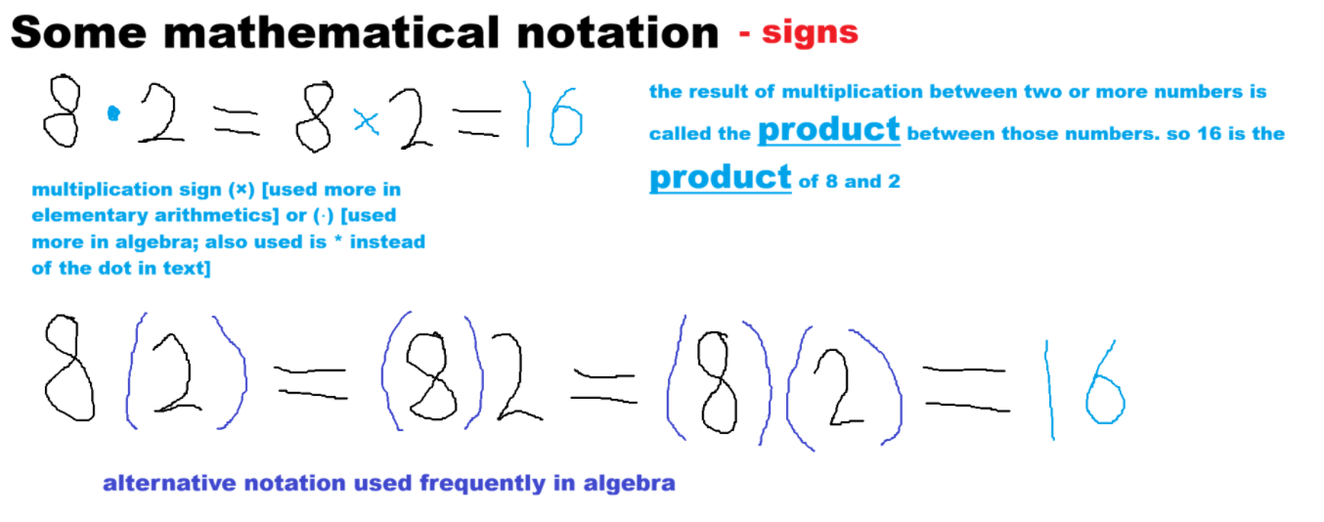
[8*(2) or (8)*2 and even (8)*(2) also possible but redundant]

Slide 7
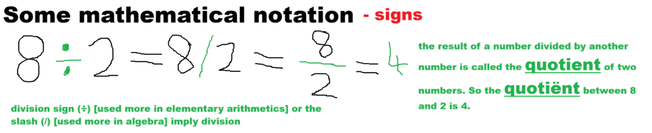

Slide 8
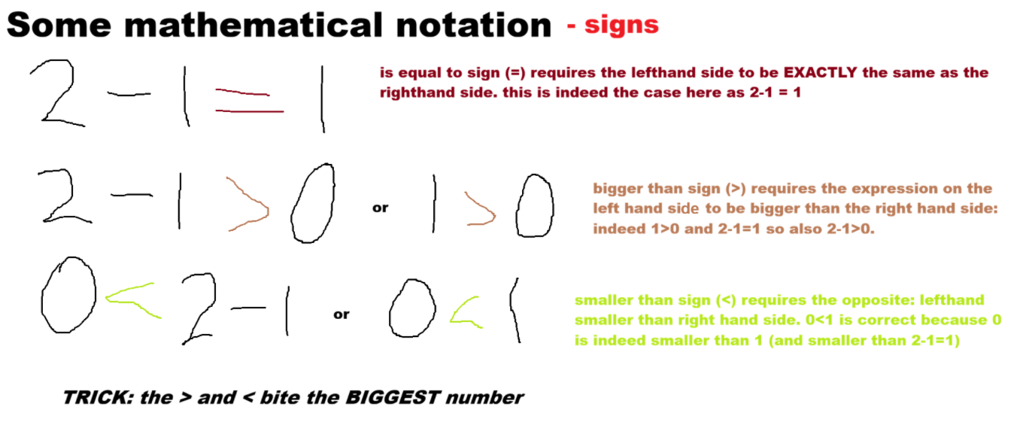

Slide 9
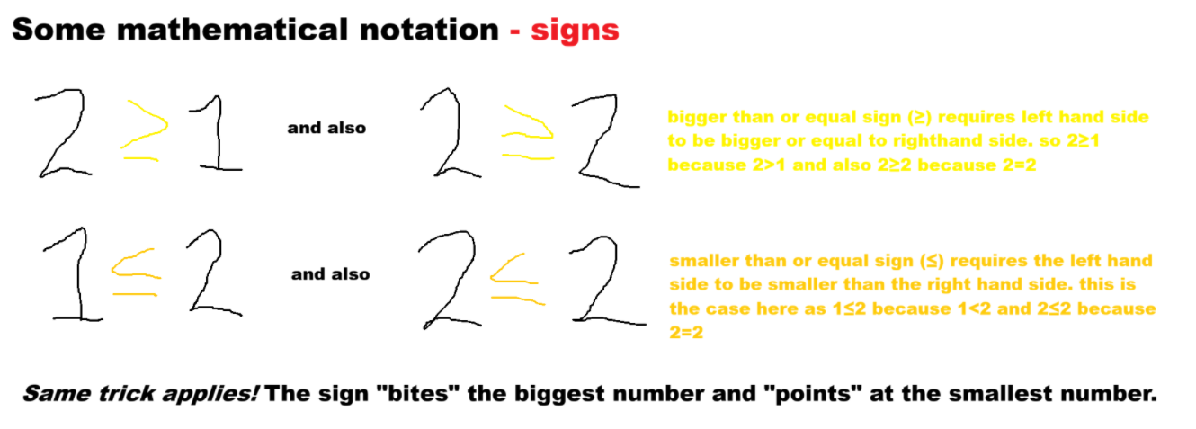

Slide 10
Commutativeness
This is basically a really fancy word that means that you can change the order around if an operator (operators are +, -, ^ etc) is commutative.
Only the operators of addition (+) and multiplication (×, ·, or *) are commutative: 3 + 4 = 4 + 3 (=7) and 2 * 5 = 5 * 2 (=10); you see I switched the numbers’ places and switching around gives me the same answer!
REMEMBER that other operators such as subtraction (-) and division (÷ or /) are NOT commutative: 4 – 3 = 1 BUT 3 – 4 = -1 (DIFFERENT!) and 6/2 = 3 but 2/6 = 1/3 (DIFFERENT AS WELL!)
Also powers/roots (are also powers technically) are NON-COMMUTATIVE: 3^2 = 9 but 2^3 = 8 and ∛2 = 2^(1/3) ≈ 1.26 whereas √3 = 3^(1/2) ≈ 1.73.
More examples you might encounter in the future but theyre not worth discussing now. MOST OF THE TIME AN OPERATOR IS NON-COMMUTATIVE!

Slide 11
